Slide 1
ALASKA2 Image Steganalysis

Slide 2
Steganography
Steganography is the art of covert communication, in which the sender hides a message in innocuous-looking objects so that the existence of the message itself is not discovered.
In this context, an unaltered object used to hide a message is called a cover object, and an altered object in which a message is embedded using steganography methods is called a stego object.
The majority of modern steganography uses digital images as cover objects and embeds messages by modifying them so slightly that the human eye can barely see the difference.
Notes:
https://www.krenn.nl/univ/cry/steg/presentation/2004-01-21-presentation-steganography.pdf
https://www.wikiwand.com/en/Steganography
https://www.youtube.com/watch?v=YXGkXOeku3c&ab_channel=CryptographyforEverybody
https://www.youtube.com/watch?v=-7FBPgQDX5o&ab_channel=ChristopherLeague

Slide 3
Steganalysis
Steganalysis is the activity to detect stego objects. The trend in image steganalysis is
to use machine learning. In recent years, deep learning, which has made great achievements in the computer vision and other various fields, has also been used to improve the accuracy of detection.
However, datasets and metrics used in the vast of those researches were not based on realistic processes. Therefore, such methods were not immediately useful to practitioners.
Notes:
https://pypi.org/project/stegano/
https://www.wikiwand.com/en/Steganalysis
https://www.kaggle.com/code/tanulsingh077/steganalysis-complete-understanding-and-model
https://www.krenn.nl/univ/cry/steg/article.pdf
http://www.jjtc.com/Steganalysis/

Slide 4
ALASKA #1 Overview - a new challenge dedicated to practical steganalysis
The goal of the ALASKA challenge was to stimulate the development of new hidden data detection methods dedicated to perform practical, “real-life”, steganalysis; i.e. to detect stego contents in environments which are closer to an operational forensic analyst context.
ALASKA was built from the observation that the vast majority of publications on steganalysis are not based on realistic assumptions, i.e. cannot be used directly by a forensics expert.
Notes:
https://hal.archives-ouvertes.fr/hal-02147763/document
2010 contest
Break Our Steganographic System (BOSS)
2017 contest
https://www.kaggle.com/competitions/sp-society-camera-model-identification/data
The figures show that the typical academic scenario of steganalysis is very far from realistic setups.

Slide 6
The ALASKA challenges were designed to address these
issues. To evaluate accuracy in a realistic setting, the chal-
lenges have some unique features. One is that the targeted
steganography methods are designed for color JPEG images
with various quality factors. This is because while the majority
of images in the real world are color JPEG images, much of
the research is on uncompressed or gray images

Slide 7
ALASKA2 Image Dataset
Goal:
Determine which of the images in the test set have hidden messages embedded.
Dataset:
JPEG compressed images datasets:
Unaltered images ("Cover" image)
Corresponding examples in which information has been hidden using one of three steganography algorithms (JMiPOD, JUNIWARD, UERD).
Notes:
https://hal-utt.archives-ouvertes.fr/hal-02950094/document
https://alaska.utt.fr/#material
of size 512x512, 256x256 for easy use in Deep learning and various sizes
JPEG stegencryption -
The universally adopted JPEG compression scheme and its relative simplicity to be modified.

Slide 8
Available information (test set):
Length of hidden messages (the payload) will not be provided.
Each embedding algorithm is used with the same probability.
The payload is adjusted such that the "difficulty" is approximately the same regardless the content of the image. Images with smooth content are used to hide shorter messages while highly textured images will be used to hide more secret bits. The payload is adjusted in the same manner for testing and training sets.
The average message length is 0.4 bit per non-zero AC DCT coefficient.
The images are all compressed with one of the three following JPEG quality factors: 95, 90 or 75.

Slide 9
Files
Cover/ contains 75k unaltered images meant for use in training.
JMiPOD/ contains 75k examples of the JMiPOD algorithm applied to the cover images.
UNIWARD/contains 75k examples of the JUNIWARD algorithm applied to the cover images.
UERD/ contains 75k examples of the UERD algorithm applied to the cover images.
Test/ contains 10k from etch folder(Cover, JMiPOD, UNIWARD, UERD) test set images.

Slide 10
Data-embedding algorithms
Data can be hidden within images using 3 main algorithms -
JMiPOD
JUNIWARD - Universal Wavelet Relative Distortion
UERD - Uniform Embedding Revisited Distortion
https://jis-eurasipjournals.springeropen.com/track/pdf/10.1186/1687-417X-2014-1.pdf

Slide 11
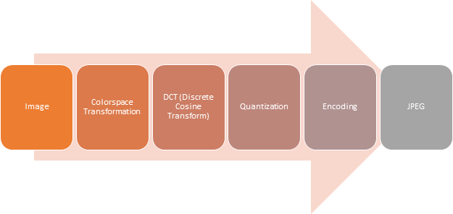
Introduction to JPEG
JPEG is not a file format , it's a compressing algorithm for an image file to reduce its size, without losing a lot of information. Steps involved in compressing an image using JPEG image :
Notes:
– Hue represents the actual color that is shown.
– Saturation represents how deep the color is, going from grey (completely desaturated) to a very deep shade of the color (oversaturated).
– Luminance is how much white or black is mixed into the color. If the luminance is set to 100%, the color will be white.
GIF and BMP stegencryption:
Operates in low bit planes
Subject to visual attacks
https://www.cs.bgu.ac.il/~dip192/wiki.files/JPEG.pdf
https://www.youtube.com/watch?v=n_uNPbdenRs&ab_channel=Computerphile

Slide 12
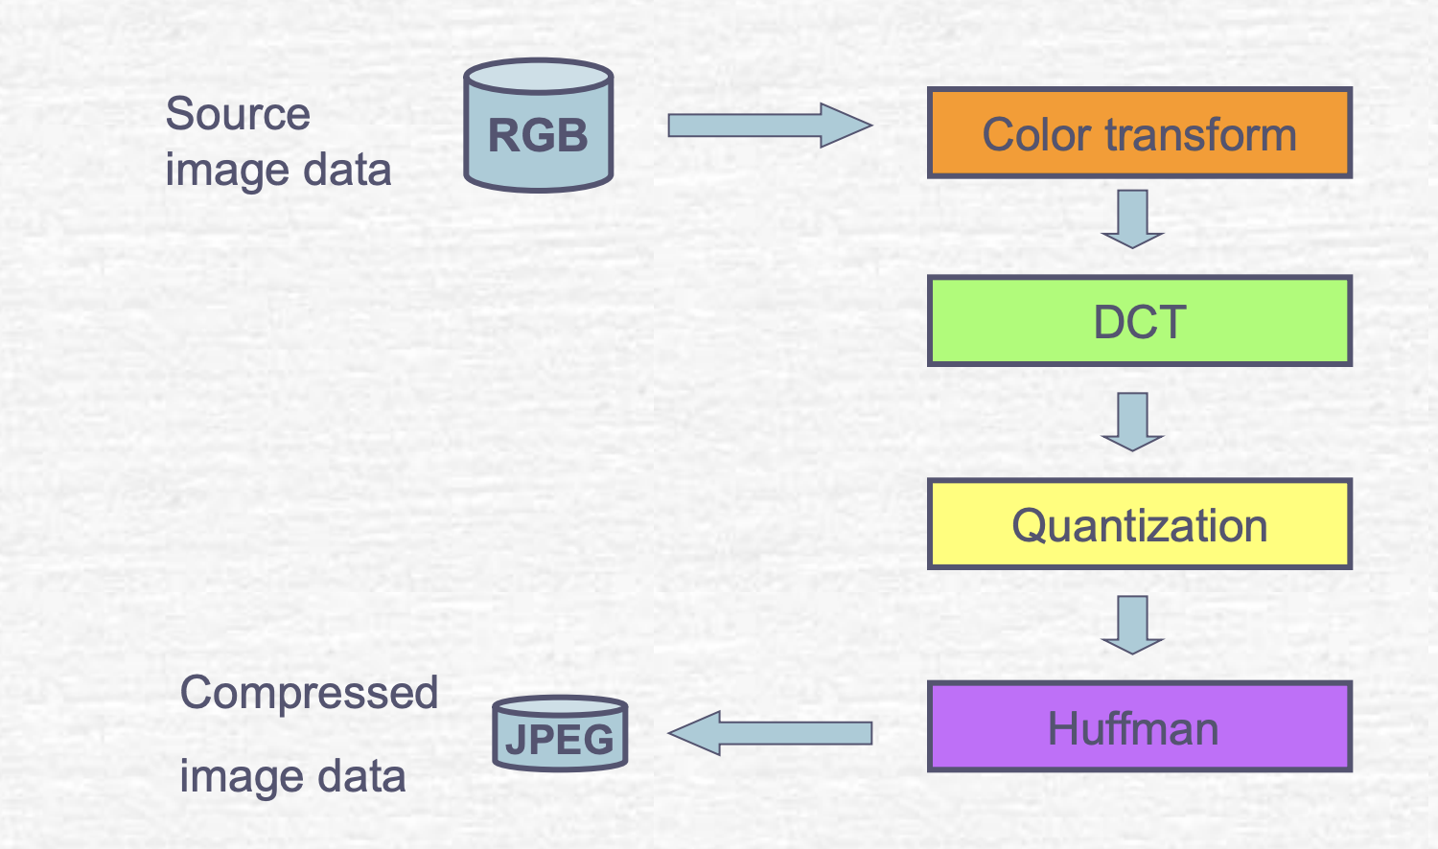
Notes:
Source:
https://www.cs.bgu.ac.il/~dip192/wiki.files/JPEG.pdf

Slide 13
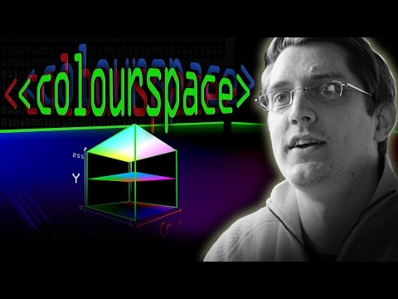
Colour Spaces
A way of representing the colors of an image.
YCbCr color model:
YCbCr model exploits the property of the visual system that more sensitive to changes luminance than to change hue.

Slide 14
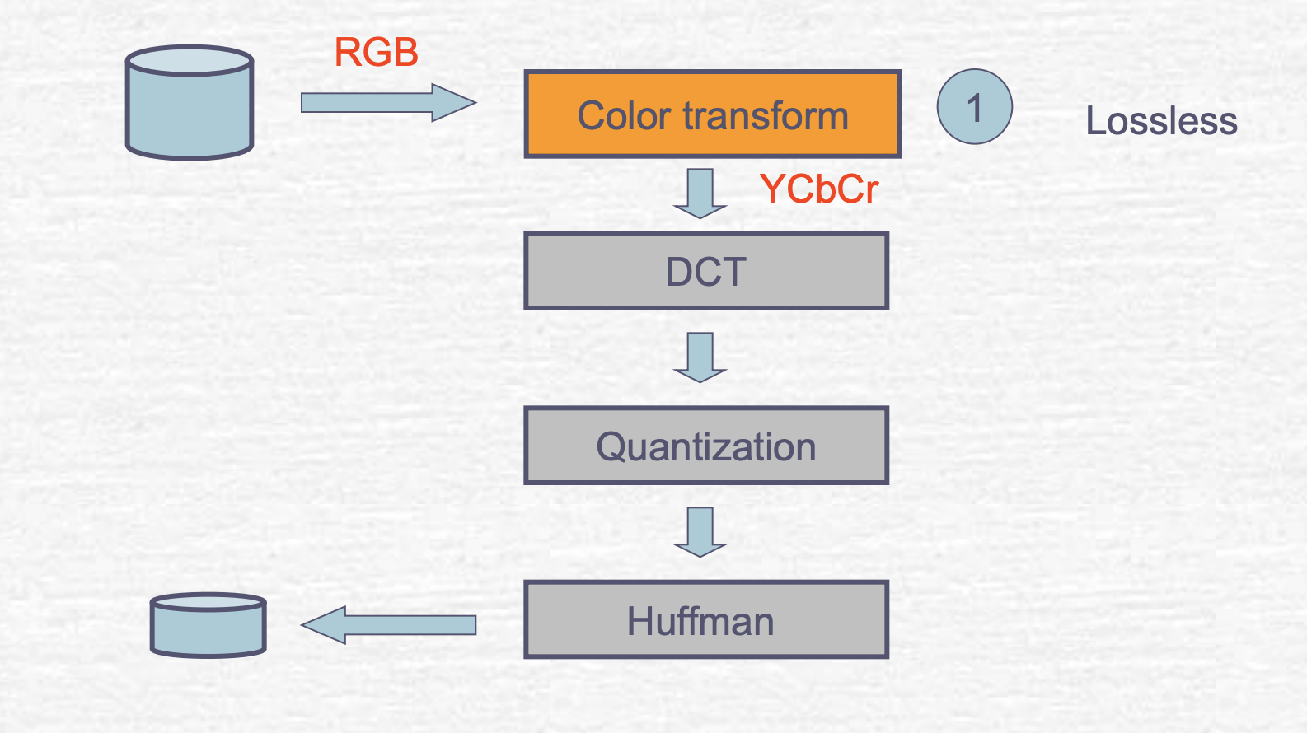
Step1: color transformation
Notes:
Chroma subsampling - we can see differences in brightness easily compared to differences in color.
JPEG can throw away some color information.

Slide 15
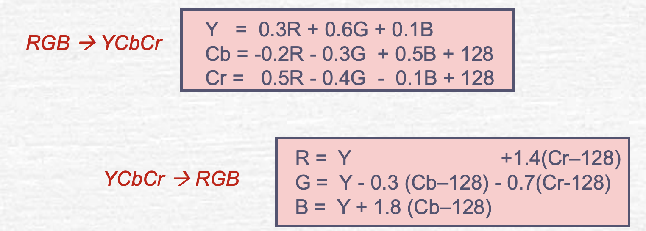
Color Space Transformation
Firstly the image is converted into YCbCr from RGB channels. YCbCr and RGB are both color spaces having different channels where YCbCr consists of three channels as Luminance(Y), Cb and Cr are the chromaticity - Cb (Cb is blue minus luma (B-Y)), Cr (Cr is red minus luma (R-Y)).
Only Y component will show black/white TV.
More bits are used for Y, and less bits for Cb or Cr.
Notes:
No for grayscale image.
From RGB to luminance/chrominance color mode.
Enable to compress more in chrominance component.

Slide 16
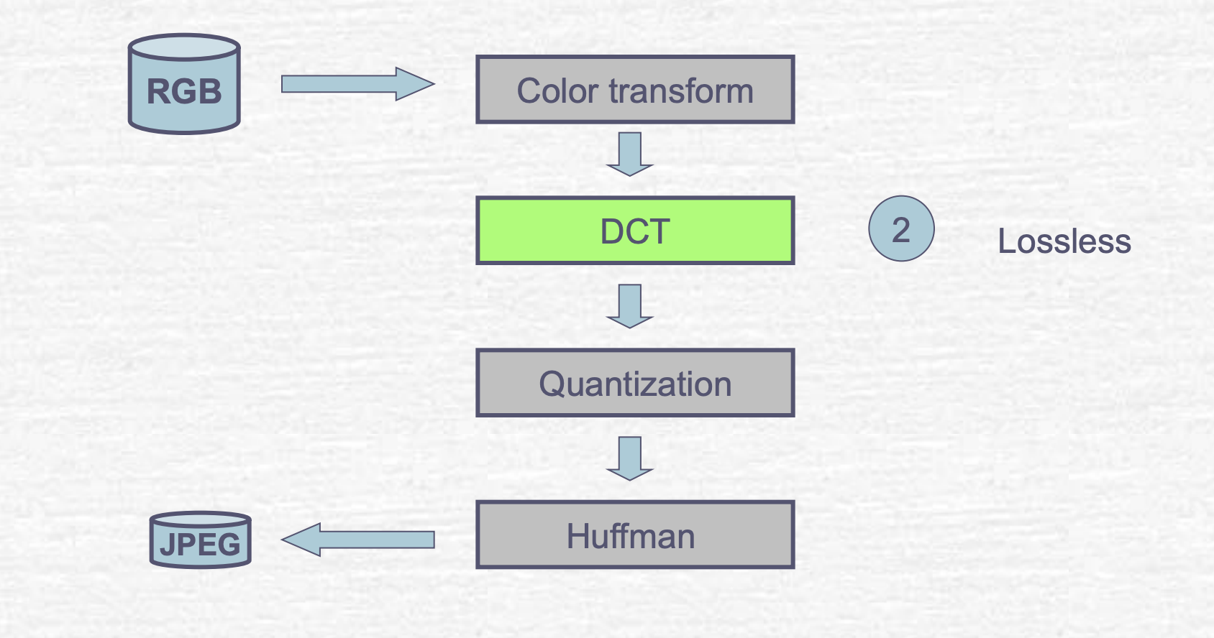
Step 2 : Discrete Cosine Transform

Slide 17
JPEG Encoding & DCT
The most widely used lossy compression algorithm is the discrete cosine transform (DCT), first published by Nasir Ahmed, T. Natarajan and K. R. Rao in 1974.
The human eye has difficulty identifying details that are very close together.
Such details can be discarded without apparent loss of quality.
But how do we identify this?
In order to find such details, we have to represent an image in terms of its frequencies.
Understanding Frequency
Sine wave: repeats at a fixed interval
Frequency: number of occurrences of the repeating segment per unit time.

Slide 18
Expressing Images in Frequencies
Instead of dealing with amplitude of sound - intensities of pixels on an image.
How to work out frequency representation from an image?
Highest frequencies - where our eyes not good at detect changes at details that are close together
DCT helps us separate these frequency from the rest of the image.
Given a complex final image, we want to break it down to individual frequencies.
DCT helps you identify what to throw away.
In Quantization we throw away data - represent a varying level using a limited number of bits.
When JPEG tries to compress an image, a lot less bits to the high frequency components whereas for lower frequencies more bits are used as the changes are more apparent.
When JPEG compresses the image it chpos down the image to little chunks of 8 by 8 pixels and each one of these little blocks are are actually represented by their own DCT grid. This also explains why when you’re looking at a high compressed image you might actually see little squares, an effect called macroblocking and as a result of the image being split into little 8 by 8 chunks for DCT processing.
The one step can control, when saving a JPEG image, you’re asked what quality you want the image to be in. The setting determines how aggressive the quantization is. Now we can write it to disk as a series of bits, but that won’t be efficient. The last step of JEG compression basically does something similar to how you would compress a text file.
Huffman coding - in text file - save ASCII characters as plain text file then every character is 8 bits. That seems rather wasteful, some chars are rare and some are not but are represented with the same amount of bits. This is what Huffman coding tries to tackle, it looks through frequency of letters in text, letters that appear most often are altered to the least number of bits. Chars more rare - more bits. It takes a look at the incoming information first and generates of the fly an encoding scheme that works best for the incoming input. The compression is tailored to the input.
JPEG - Huffman coding looks at the information it has to encode and decides which elements occur very often - a lot less bits for them, whereas pieces of inputs data that occur rarely - more bits.

Slide 19
MCU - Minimum Coded Unit
8 x 8 pixels unit
Each pixel has 3 numbers associated with it, RGB.
3D array -> 8 x 8 x 3
Encoding a single color channel
Notes:
Smallest file size while suffering the minimum loss of detail

Slide 20
Y - luminance
Cb - blue
Cr - red
Notes:
YCbCr (combination creates green)

Slide 21
Compression Techniques
Transformation is a lossless step in which the image is transformed from color values to in the spatial domain to coefficients in some other domain.
No loss of information occurs in the transformation step.
Quantization is the step in which data integrity is lost.
It attempts to minimize information loss by preferentially preserving the most important coefficients, whereas less important coefficients are roughly approximated, often as zero. Quantization may be as simple as converting floating point values to integer values.
Finally, these quantized coefficients are encoded.
This also is a lossless step in which the quantized coefficients are compactly represented for efficient storage or transmission of an image.

Slide 22
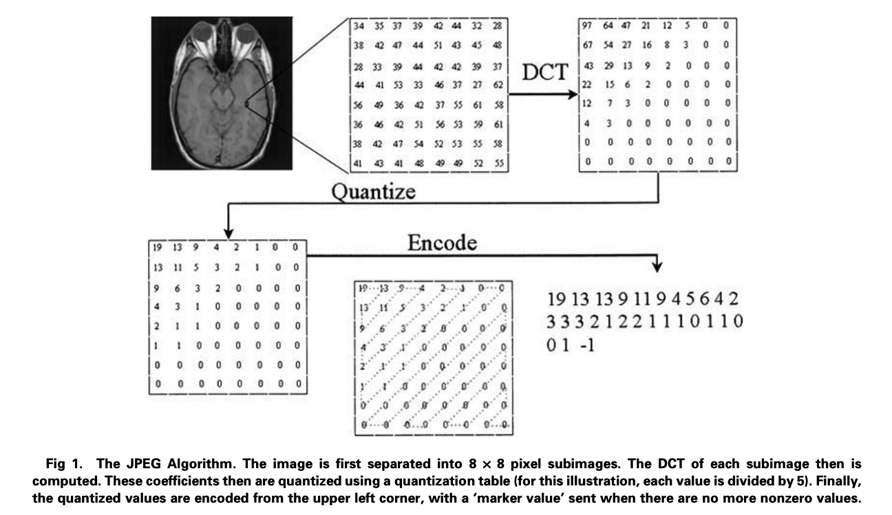
Notes:
From:
Irreversible Compression of Medical Images
April 2002 Journal of Digital Imaging 15(1):5-14
After DCT computation - most of the information is concentrated in relatively few coefficients in the upper left corner of this DCT image.

Slide 23
Quantization
The coefficients are approximated to values that are easy to represent in a small amount of space. There is an 8 x 8 table (called the quantization table) which contains the values by which corresponding coefficients are to be divided. By using different values, spectral frequencies that are more important to the visual system can be preserved preferentially over less important frequencies. The resulting values then are rounded off to the nearest integer.

Slide 24
Encoding
JPEG encodes the quantized coefficients by reordering them in a zigzag pattern. This places the largest values first, with long strings of zeros at the end, which can be efficiently represented.

Slide 25
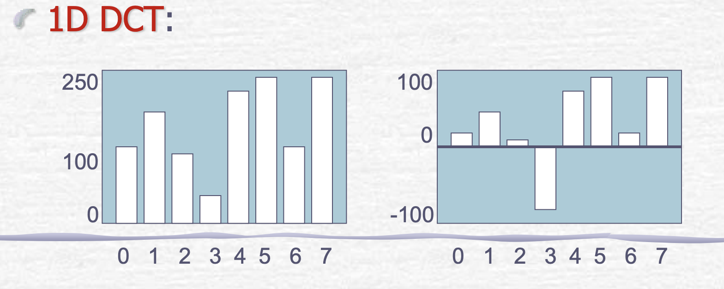
Discrete Cosine Transform
Purpose:
Convert from spatial domain to frequency domain
Be able to separate what the eye can see from imperceptible

Slide 26
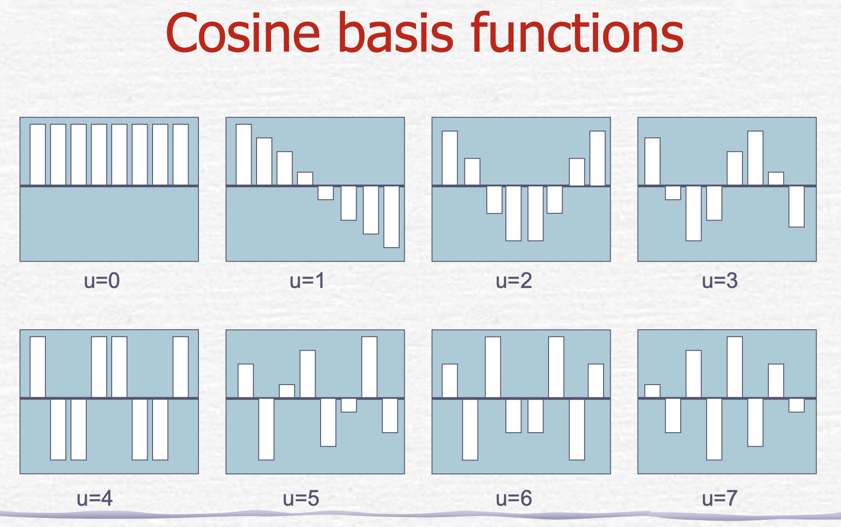

Slide 27
Cosine basis function
A set of waveforms is orthogonal
Orthogonal waveforms are independent
A set of waveforms scaled and added together can represent any eight samples
DC coefficient (u=0)
Scales the constant basis function (average value)
AC coefficients
The higher the frequency the less important the coefficient

Slide 28
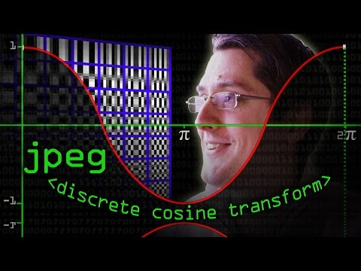
The Discrete Cosine Transform (DCT)
DCT is applied on the pixels of the color channels, using DCT coefficient.
https://towardsdatascience.com/revisiting-dct-domain-deep-learning-51458fe2e6e4
The image encoded using JPEG algorithm stays in YCbCr colorspace until it is decoded by an Image viewer software. When a JPEG is read it is decoded and converted back to RGB colorspace to be rendered on screen using the techniques described in the video above.
Notes:
https://www.wikiwand.com/en/Discrete_cosine_transform
http://cs.haifa.ac.il/~nimrod/Compression/JPEG/J4DCT-Huff2007-2spp.pdf

Slide 29
DCT coefficients

Slide 30
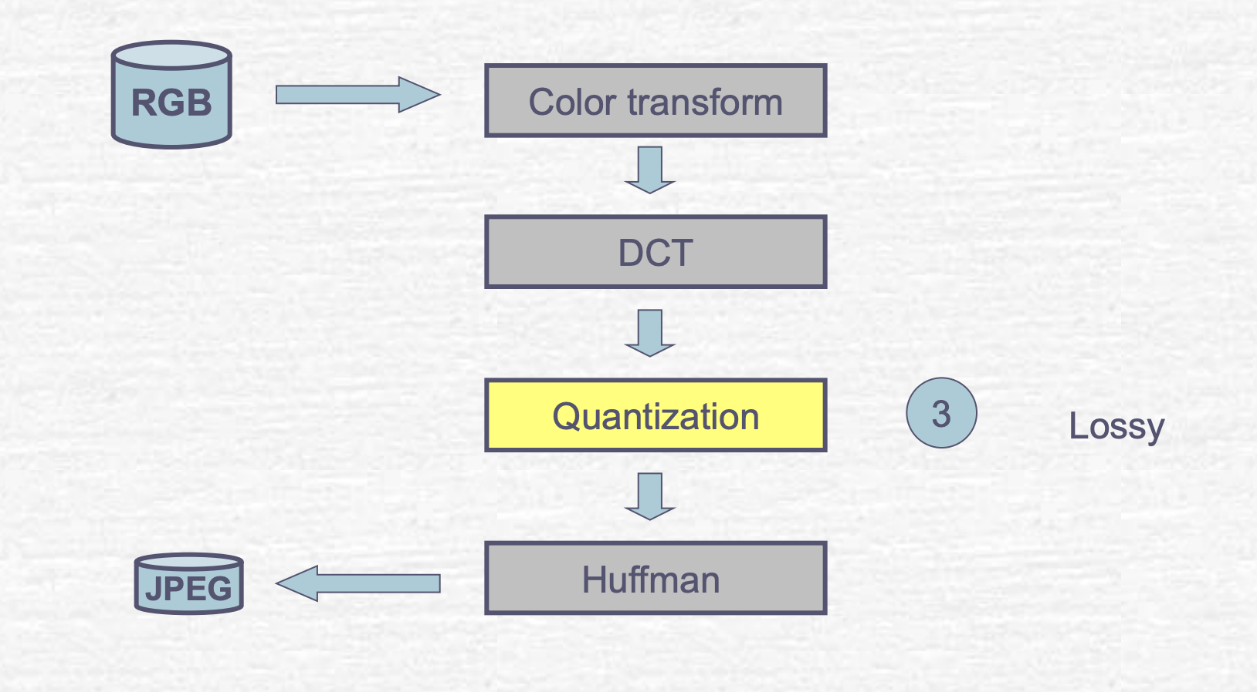
Step 3: Quantization

Slide 31
Quantization
Purpose:
Eliminate less significant information
Low frequency coefficients have smaller quantization steps, therefore more accurately encoded
Luminance data is quantized more accurately than the chromatic data
How?
Each coefficient in each block is divided by separate quantization coefficient
Round the result to integer

Slide 32
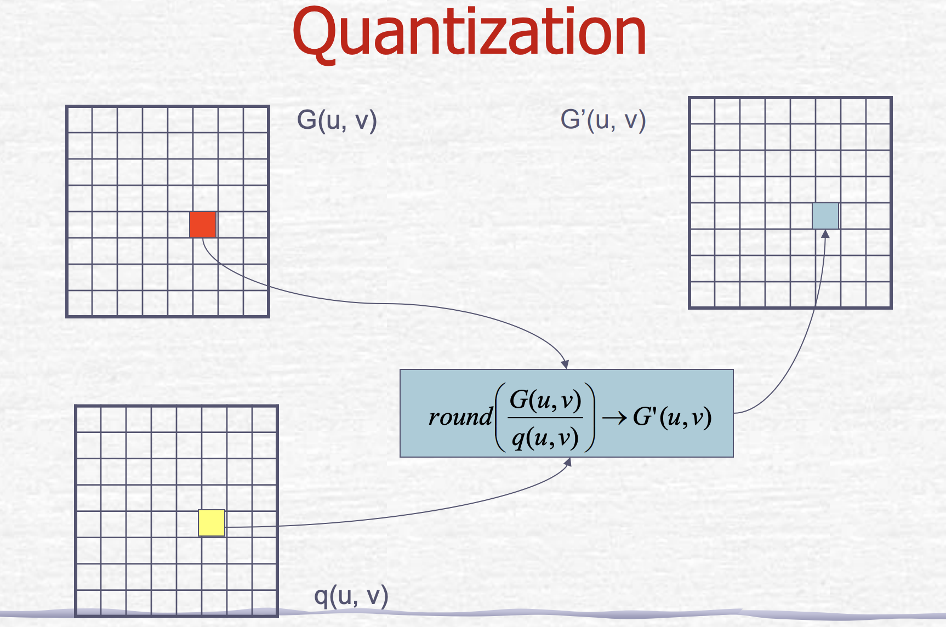

Slide 33
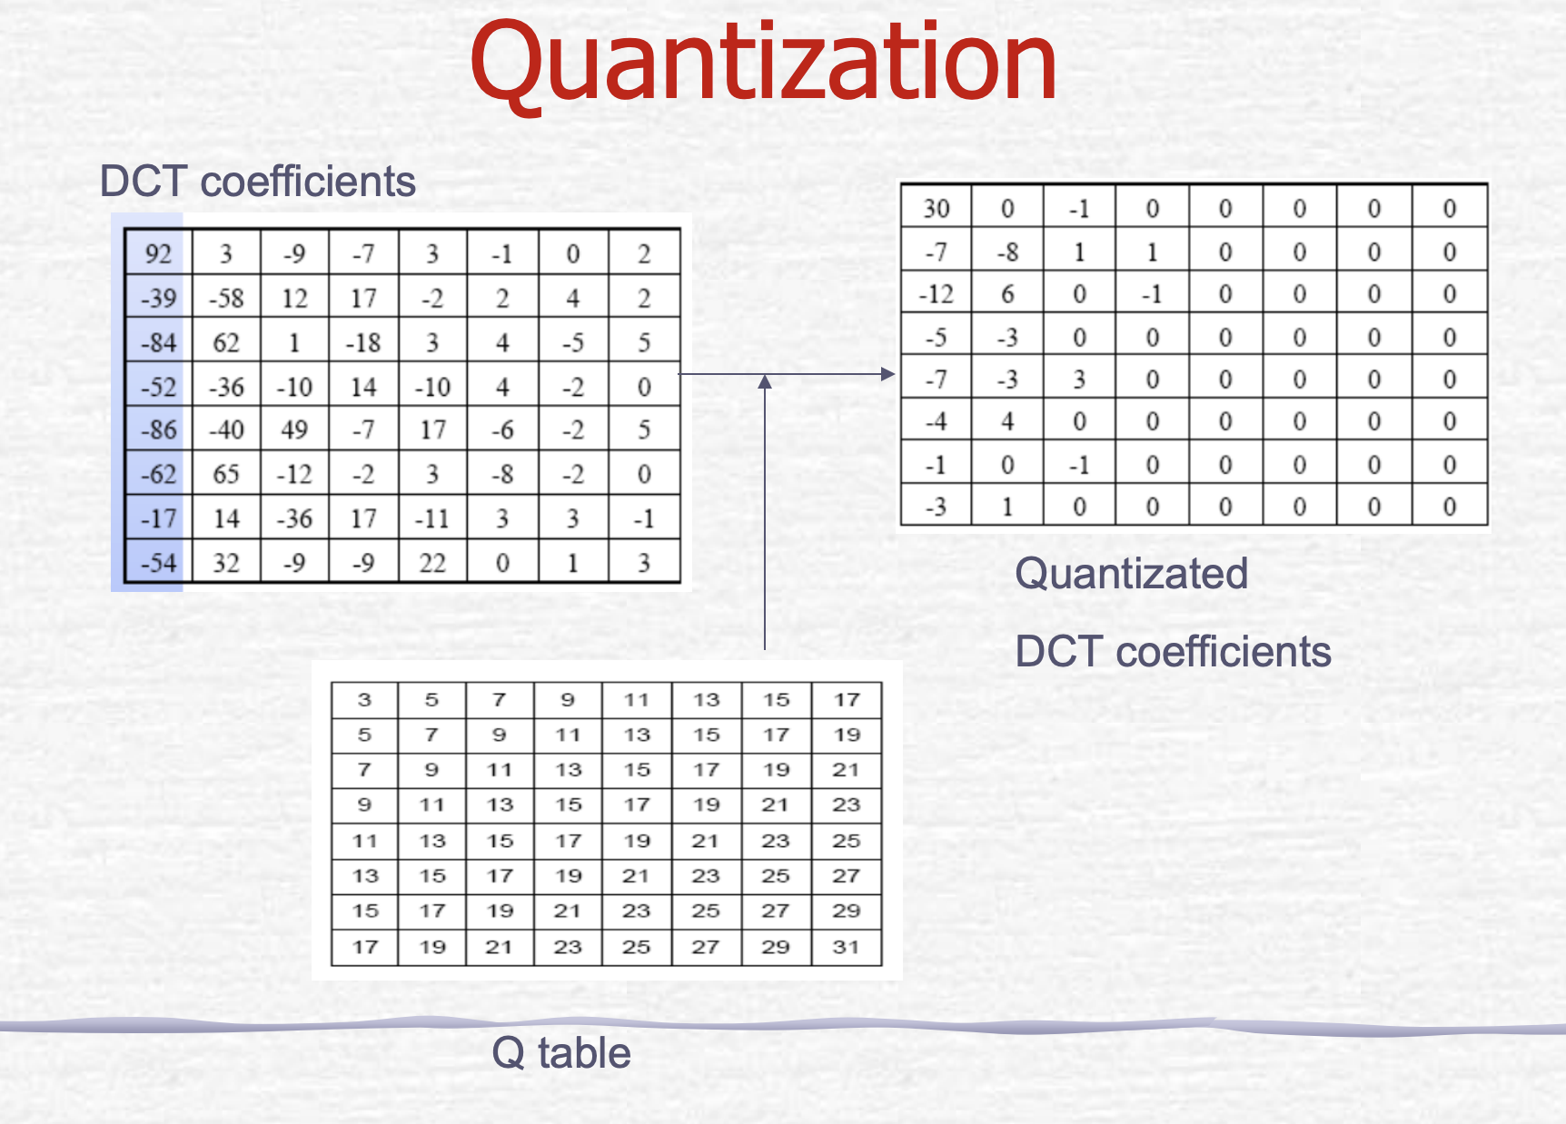

Slide 34
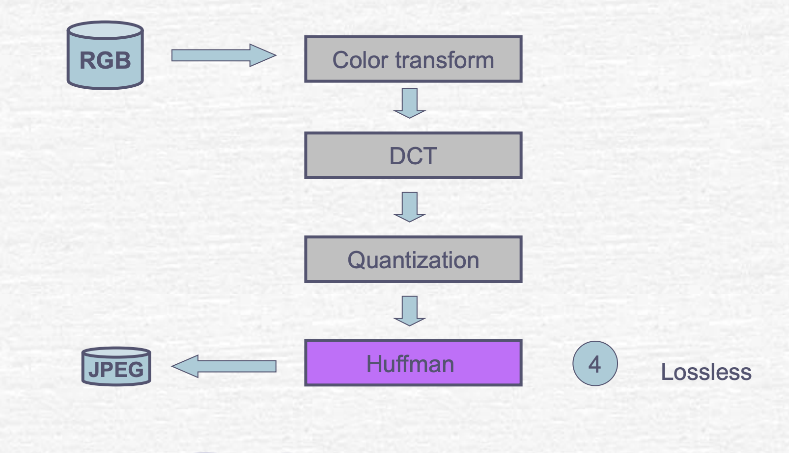
Step 4: Huffman coding

Slide 35
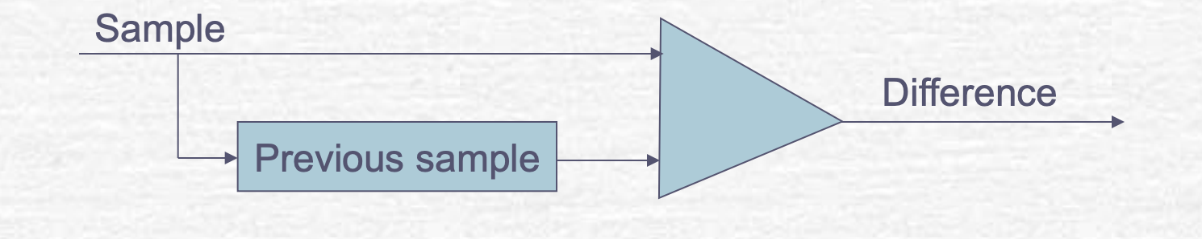
Coding
DC coefficient
Encode the difference between the value and already coded value
AC coefficient
Huffman code: less bits for common values

Slide 36
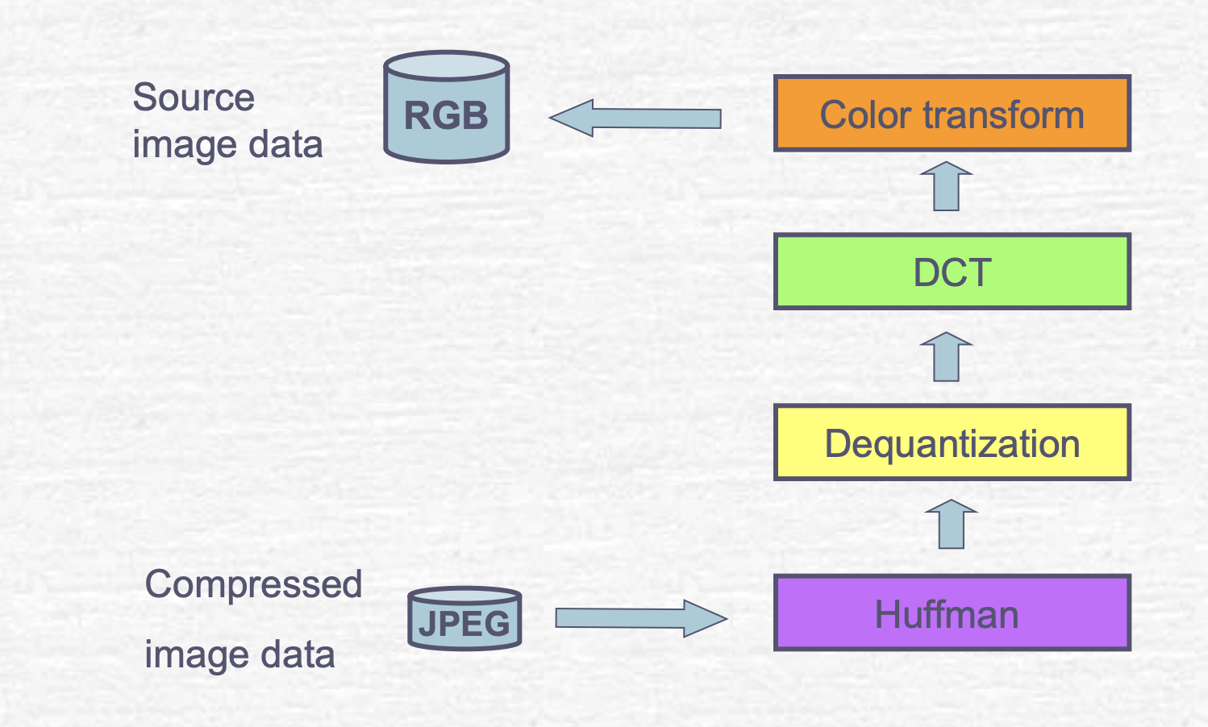
JPEG decoder

Slide 37
Spatial or DCT domain

Slide 38
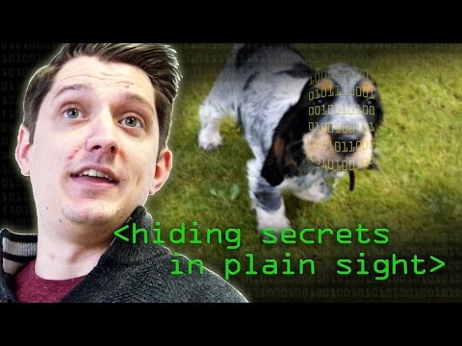
Potential hiding spots of information
Channels of the respective color Spaces like RGB and YCbCr
These were the techniques used in the starting algorithms but as we have seen it is easily recognizable even using naive approach, so people started to find a new technique for hiding information.
DCT coeffs of different channels
The more newer approaches hide information in the DCT coeffs of different channels of JPEG image and that the payload too is randomly distributed among them taking into the statistics of DCT coeffs

Slide 39
Adam Optimization Algorithm
Adaptive Moment Estimation Optimizer
Notes:
what optimizer should we choose? AdamP, AdamW
do we need to reshape the pixels matrix
loss function should wwe choose? CrossEntropy Loss

Slide 40
Regularization
regularization: dropouts, early stopping (callback), change gradualy the lr (callback)

Slide 41
Transfer Learning (imagenet)

Slide 42
data augmentation (Flip, Rotate90, Cutout, GridShuffle, GridDropout Augmentations in stages

Slide 43
Augmentations
Albumentations library for Data Augmentation
Faster than torchvision in every benchmark
Has support for more tasks like segmentation and detection
Notes:
https://www.youtube.com/watch?v=rAdLwKJBvPM&ab_channel=AladdinPersson

Slide 44
Evaluation Criterion
a weighted area under curve (wAUC)
Let us recall that the ROC curve plots the true-positive rate β against the false-alarm rate α0. The area under the curve is defined as:
Notes:
we had to use as an evaluation criterion a metric that was used by the Kaggle platform. While we initially wanted to focus on reliable detection (with very low false alarm rates such as the false alarm probability for 50% detection accuracy F P50 or the probability of missed detection for probability of false alarm 0.05) such option was not available from Kaggle. Besides, we have been strongly advised to use a score that measures the overall accuracy, not only at one specific functional point to avoid distinguishing team by only a few images. Therefore, we decided to move to a weighted area under curve (wAUC)

Slide 45
Implementation
Cover image
Identify redundant data
Replace (a subset of) redundant bits with data
JPEG uses discrete cosine transformations (DCT)
Transform pixel blocks to DCT coefficients
Get least significant bit of each DCT coefficient
Replace LSB with secret message bit
Insert modified DCT into output image

Slide 46
Notes from the contest #1:
Dealing with Different JPEG Quality Factors:
It does not seem that having one specific network for each JPEG quality factor brought much detection accuracy.
All users who tried learning over each JPEG quality factor individually did not get significant improvements and, hence, eventually decided to analyze all images together regardless the QF in order to benefit from a larger dataset for training.
It goes completely against what has always been observed for features based steganalysis and that was common belief also for deep learning based steganalysis. In the problem of “holistic vs atomistic” steganalysis (should you learn a specific network over each possible dataset for more tailored detectors or blend all images together for more robustness) the JPEG quality factor has long been recognized as the sole parameter that may prevent generalization.
Notes:
https://github.com/RishiMalhotra920/Image-Steganalysis

Slide 47
Notes from the contest #2:
Dealing with Different Color Channels:
Whether the RGB color space was more relevant because Deep Learning architectures are usually designed for this case, or whether YCbCRr would be more relevant since data hiding is made on this components. Similarly, whether one should use spatial or DCT domain was also addressed. All in all, it seems that it is more efficient to analyze images in the spatial domain, which was in line with has been long recognized in steganalysis.
However, it seems that diversifying allows slightly improving the performance as we have observed top users using both spatial and DCT domain or several color spaces.

Slide 48
Regarding the color channels itself, it seems that it choice does not matter for steganalysis. Perhaps because they all mostly consists in linear transformation that a complex network can eventually figure out, similar performances have been observed in RGB, YUV, YCbCr, L*a*b ...
Interestingly, it has been observed that using non-quantized values (regardless of the color channel used) slightly improve detection performance.

Slide 49
Notes from the contest #3:
Most Relevant Deep Learning Architecture:
Among the current-art Deep Learning method, undoubtedly, EfficientNet has been by far the most extensively used in this competition for its relative simplicity and high performance.
It is also possible that this is partially due to the fact that a few weeks after the kick-off an implementation with EfficientNetb2 allows getting a score as high as 0.921 (to be contrasted with the 0.935 of the top scorers at that time). Interestingly, it can be noted that MixNet also achieved high performance while ResNet and DenseNet did not.

Slide 50
one could argue that the user who finished first used mostly SEResNet18 yet removing the stride and pooling from the first two layers which prevent the downsampling of images and, ultimately, to keep much more information about such weak signals as steganography may be as well as to speed up significantly the convergence.

Slide 51
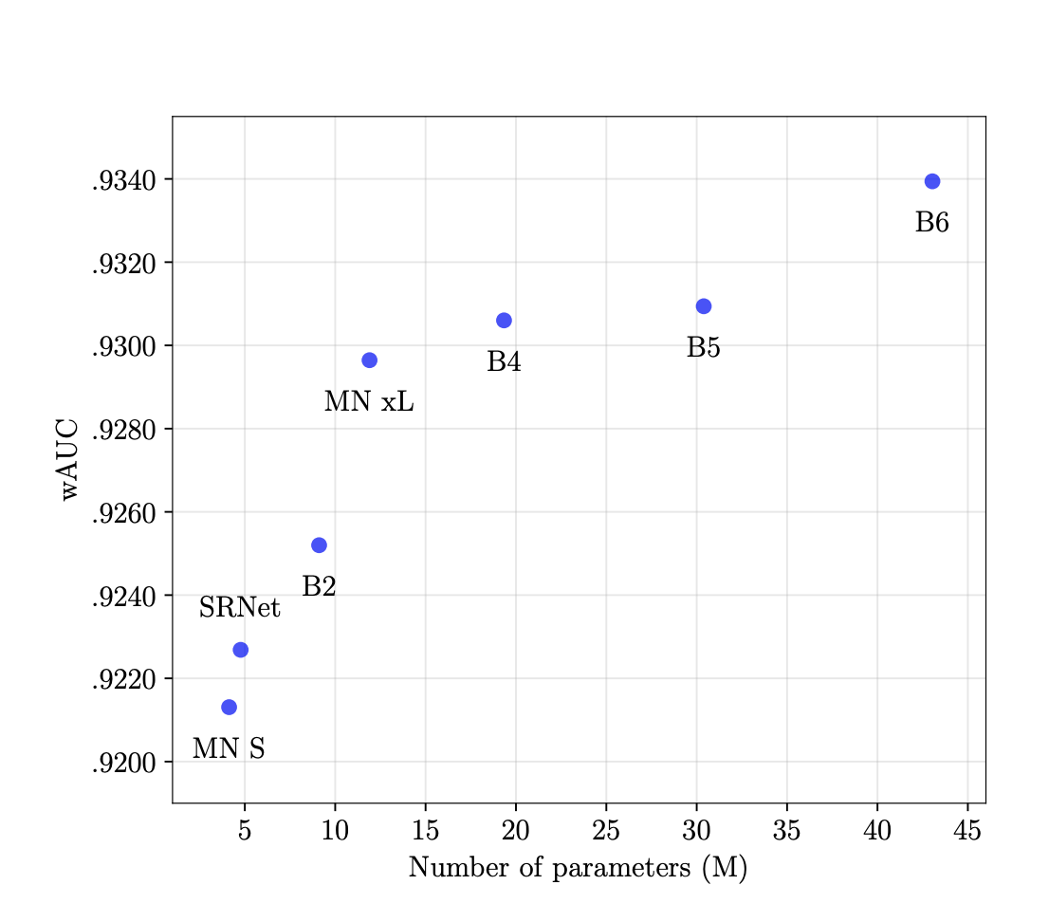
Overall performance obtained with several Deep Learning architecture (measures using the wAUC used in this competition) as a function of network complexity (measured as the number of parameters).

Slide 52
Steganalysis in DCT domain using deep learning has remained quite a challenging problem in large part because the neighboring samples are very different from each other making convolutional networks quite irrelevant. For this reason it has been quite unused. However, among those who did use DCT coefficients, undoubtedly the most successful approach has been to use the one hot encoding approach.

Slide 53
Several Tricks for Improving Detection Accuracy:
Interestingly, as we explained above, using Efficient-b2 “as it” with weights pre-trained from ImageNet already allows getting very interesting steganalysis performance significantly higher than current state-of-the-art in steganalysis, namely SRNet.
Most of the users focused on improving over performances that were already quite outstanding. The main approaches to do so has been quite classical and can be summarized as follows:

Slide 54
Use more complex yet slightly more accurate networks
Build an ensemble of classifiers using several different architectures
Diversify using several color channels and adding DCT
Train/validate over several splits and select best models
Use data augmentation strategies, such as CutMix strategy, to improve the learning efficiency ; this was used by many kagglers and especially those who ended first and third.
Eventually, it has been quite a consensual observation that training a multi-class classifier allows slightly improving the detection accuracy as compared to training a binary classifier merging all three different embedding schemes.

Slide 55
EfficientNetV2
https://www.youtube.com/watch?v=CTsSrOKSPNo&ab_channel=TheAIEpiphany

Slide 56
An ROC curve (or receiver operating characteristic curve) is a plot that summarizes the performance of a binary classification model on the positive class.
ROC Curve: Plot of False Positive Rate (x) vs. True Positive Rate (y).
TruePositiveRate = TruePositives / (TruePositives + False Negatives)
The true positive rate is referred to as the sensitivity or the recall.
FalsePositiveRate = FalsePositives / (FalsePositives + TrueNegatives)
We can think of the plot as the fraction of correct predictions for the positive class (y-axis) versus the fraction of errors for the negative class (x-axis).
Notes:
https://medium.com/towards-data-science/read-this-before-using-roc-auc-as-a-metric-c84c2d5af621

Slide 57
Weighted AUC Metric

